Slide 1
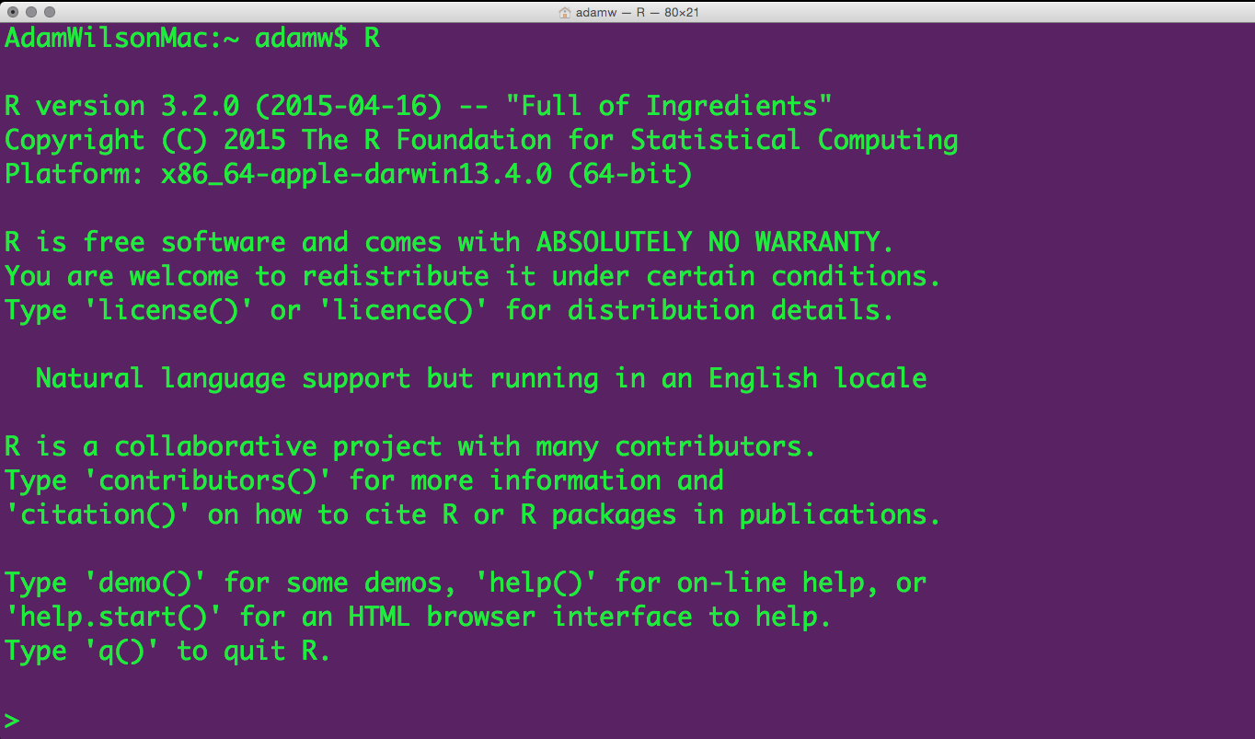
GEO 503: Spatial Data Science
Course Structure
Data Science
Why R?
Coda

Slide 2
What is data science?
Course Structure
Data Science
Why R?
Coda

Slide 3
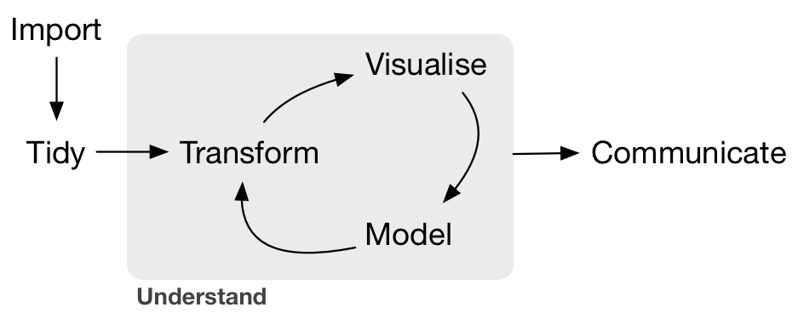
What is Spatial Data Science?
Spatial
Dimension
is Critical
Course Structure
Data Science
Why R?
Coda
--Grolemund & Wickham, R for Data Science, O'Reilly 2016

Slide 4
Spatial Data Science vs GIS
GIS
Course Structure
Data Science
Why R?
Coda

Slide 5
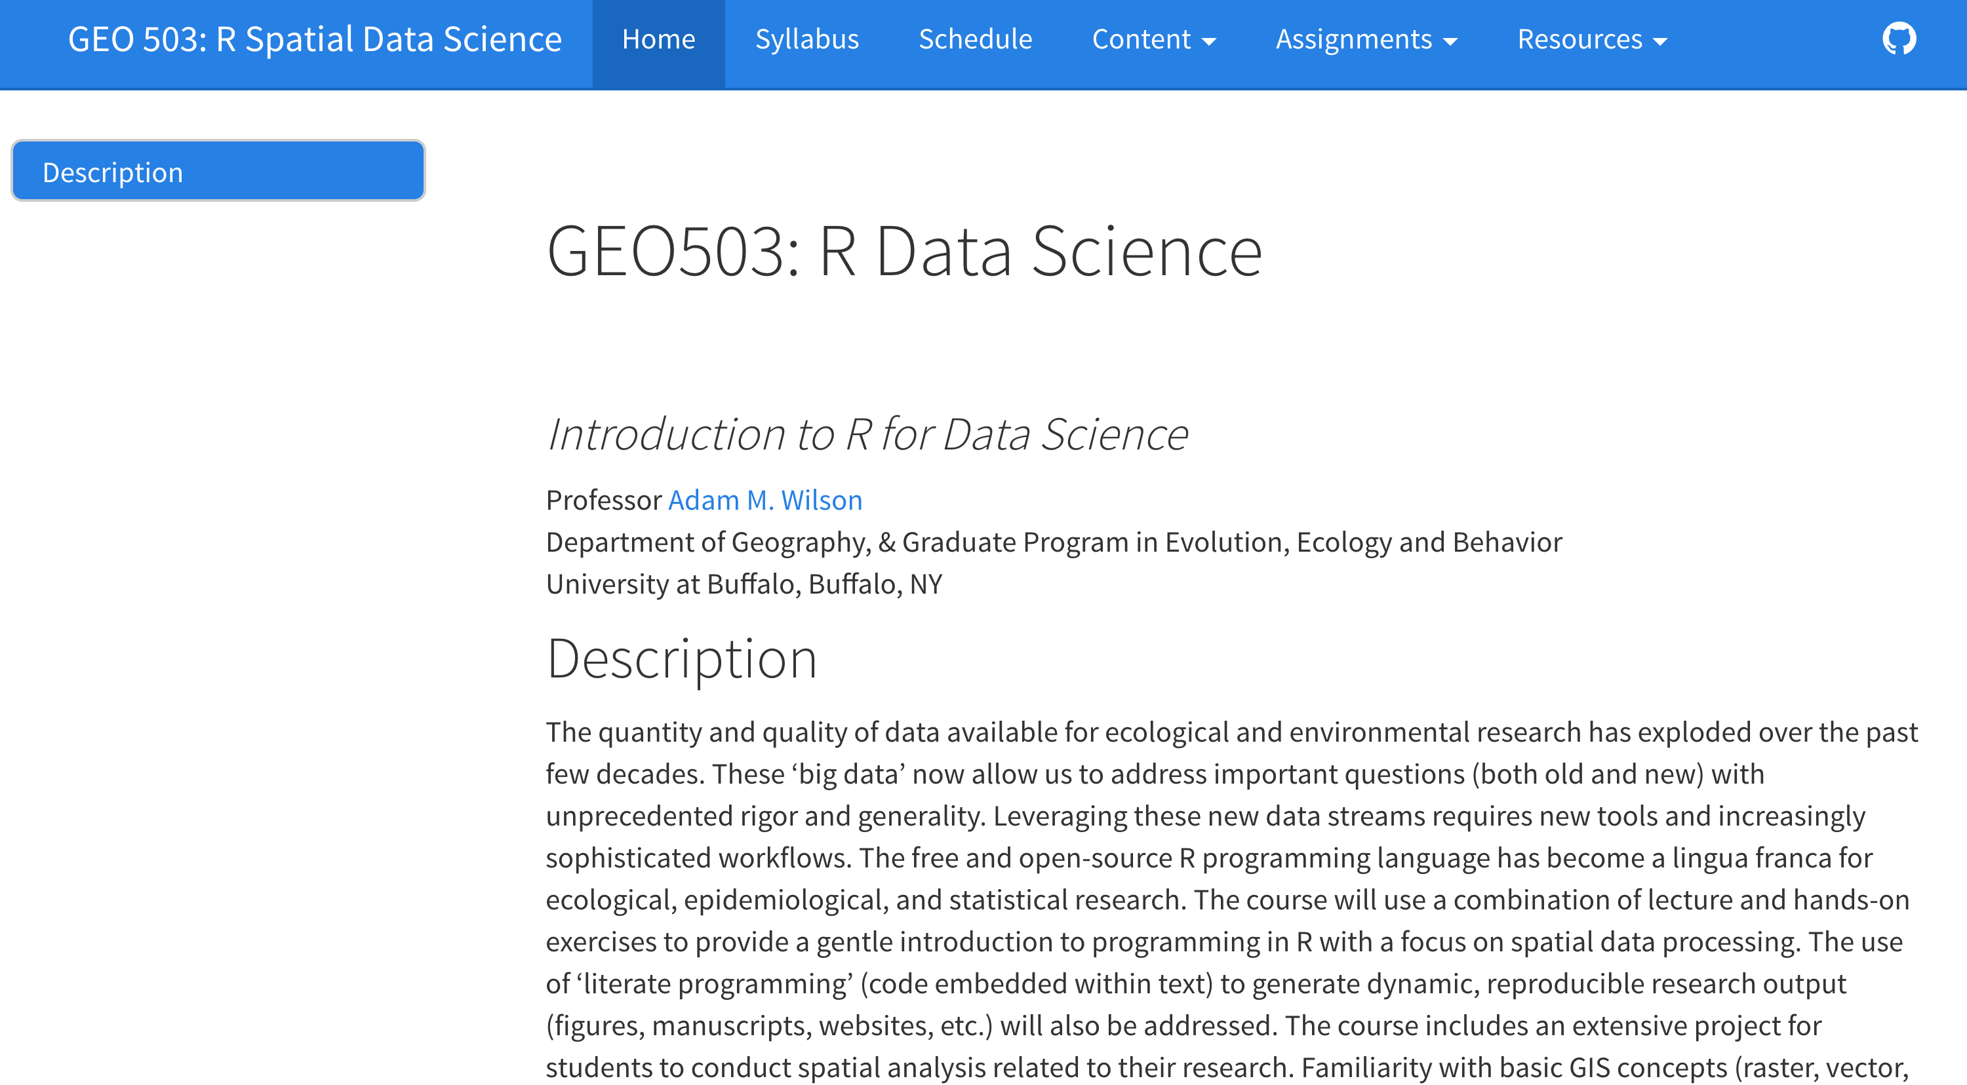
Course Website: adamwilson.us/SpatialDataScience
Course Structure
Data Science
Why R?
Coda

Slide 6
Course Structure

Slide 7
Course Structure
Tuesdays/Thursdays 2:00-3:20
Review/Questions
~30-45 Minute Presentation
Guided interactive exercises on your laptops
Course Structure
Data Science
Why R?
Coda

Slide 8
Course Objectives
4 Learning Objectives
Become familiar with R programming language
Learn to code geospatial analyses
Learn to develop custom data visualization (especially spatial)
Learn to develop reproducible research workflows
This course is NOT
A statistics course (see GEO 505, etc.).
We will focus on workflow and methods
Course Structure
Data Science
Why R?
Coda

Slide 9
Course Logistics
Course Participation 10% Package Presentation 10% Homeworks 30% Final Project 50%
On the screen
Course Structure
Data Science
Why R?
Coda

Slide 10
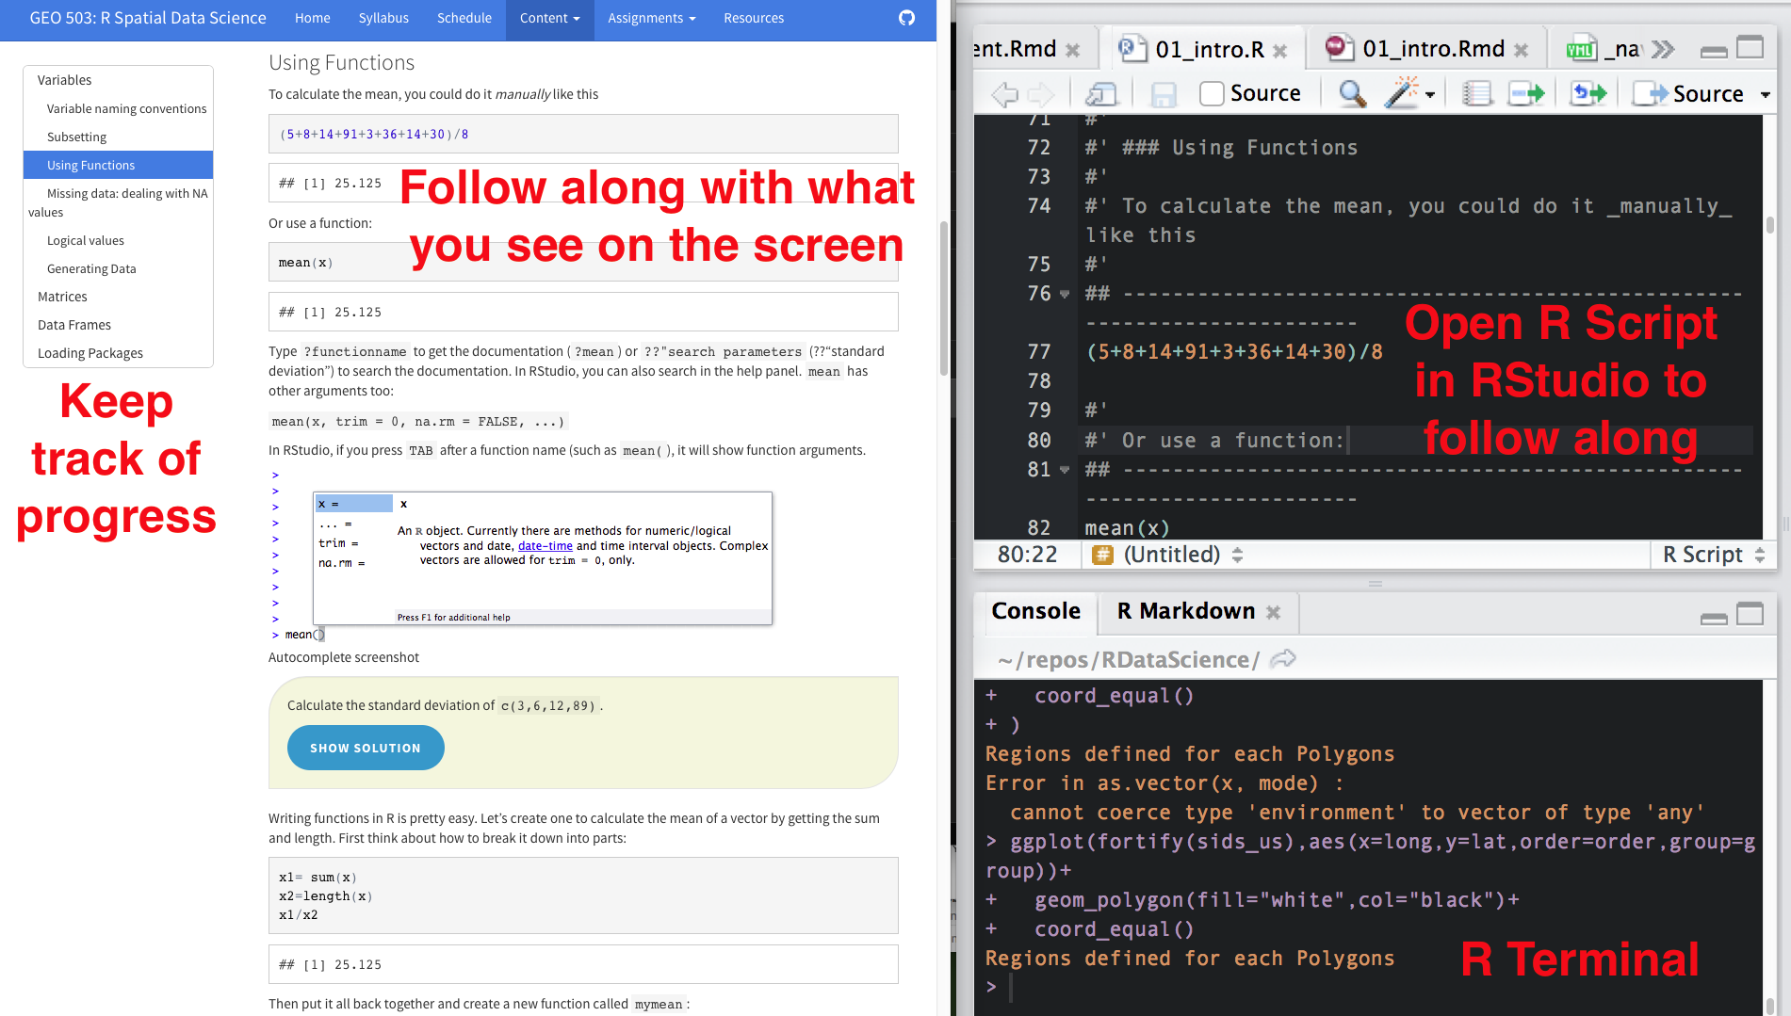
Course Participation (10%)
On the screen
Course Structure
Data Science
Why R?
Coda

Slide 11
Package Introduction (10%)
Introduce R package in 5 min presentation
Objectives:
Learn how to find/download/install a new package and use it
Teach your peers about useful R packages
The presentation must include:
What does the package do? (1-2 slides, 1 minute)
Author introduction (1 slide, 1 minute)
Simple demonstration (2-3 slides, 3 minutes)
Course Structure
Data Science
Why R?
Coda

Slide 12
Homework (30%)
#' ## Question 1
#' Load the iris dataset by running
## ------------------------------------------------------------------------
data(iris)
#'
#' > How many observations (rows) are there for the versicolor species?
#'
#' _______________________
Course Structure
Data Science
Why R?
Coda

Slide 13
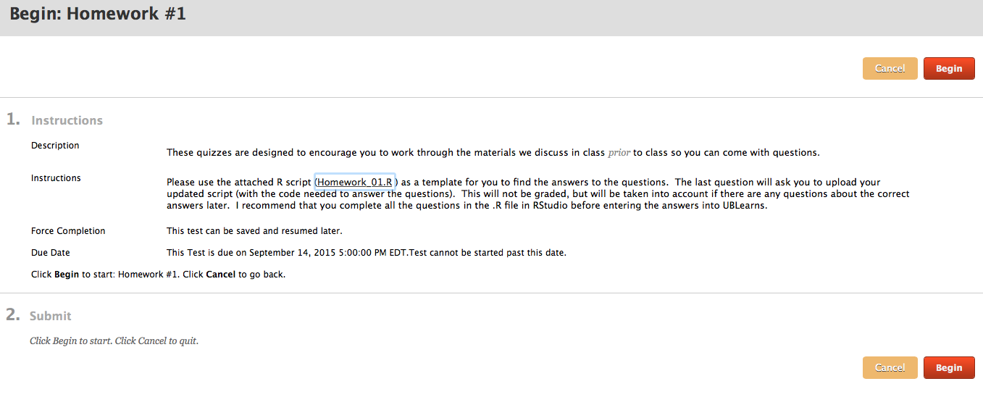
Homework submitted in UBlearns
Working collaboratively is encouraged but you are responsible for developing your own code to answer the questions:
Acceptable: “which functions did you use to answer #4?”
Unacceptable:“please email me your code for #4.”
Course Structure
Data Science
Why R?
Coda

Slide 14
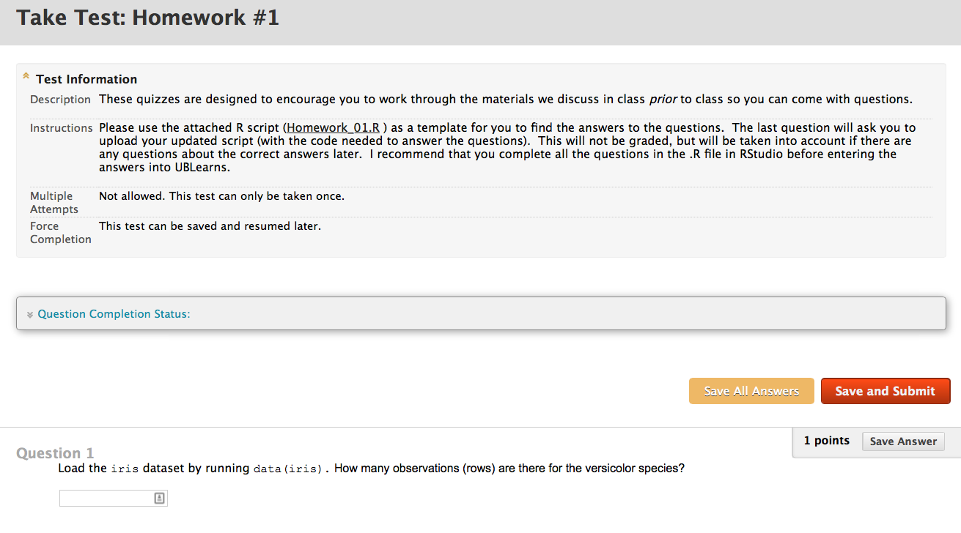
Homework format
Course Structure
Data Science
Why R?
Coda

Slide 15
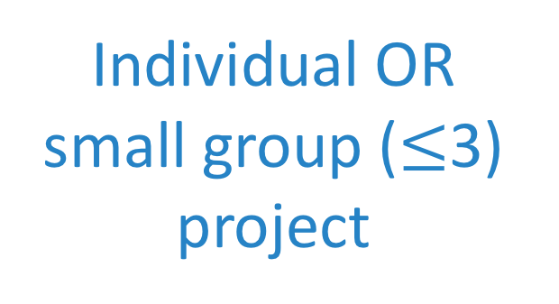
Final Project (50%)
Title (<25 words)
Introduction [~ 200 words, 10%]
Materials and methods [~ 200 words]
Narrative (10%)
Code (25%)
Data (5%)
Results [~200 words, 25%]
Conclusions [~200 words, 5%]
References [5%]
Individual OR small group ($≤$3) project
Course Structure
Data Science
Why R?
Coda

Slide 16
"It takes intelligence, even brilliance, to condense and focus information into a clear, simple presentation that will be read and remembered.
Ignorance and arrogance are shown in a crowded, complicated, hard-to-read poster.” -- Mary Helen Briscoe

Slide 17
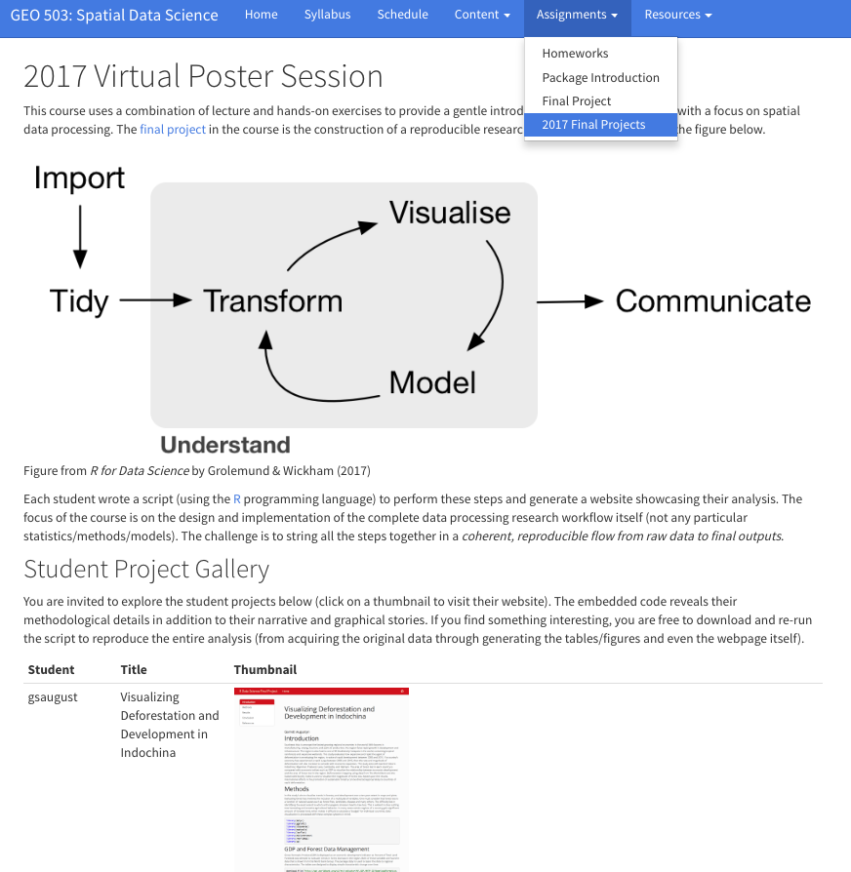
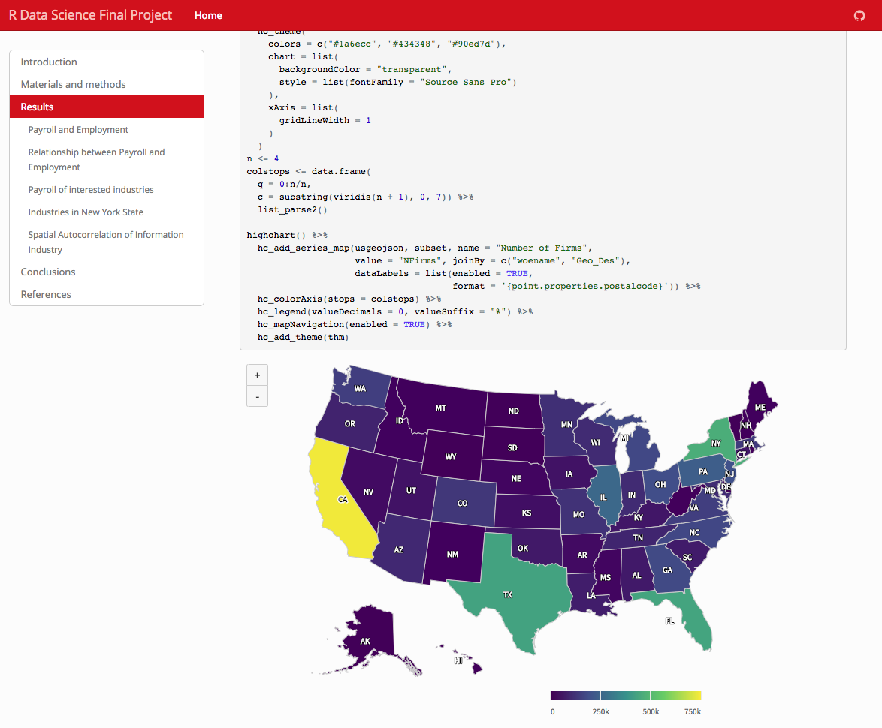
2017 Projects available to browse on website
Course Structure
Data Science
Why R?
Coda

Slide 18
What is Data Science?
Course Structure
Data Science
Why R?
Coda
--Grolemund & Wickham, R for Data Science, O'Reilly 2016

Slide 19
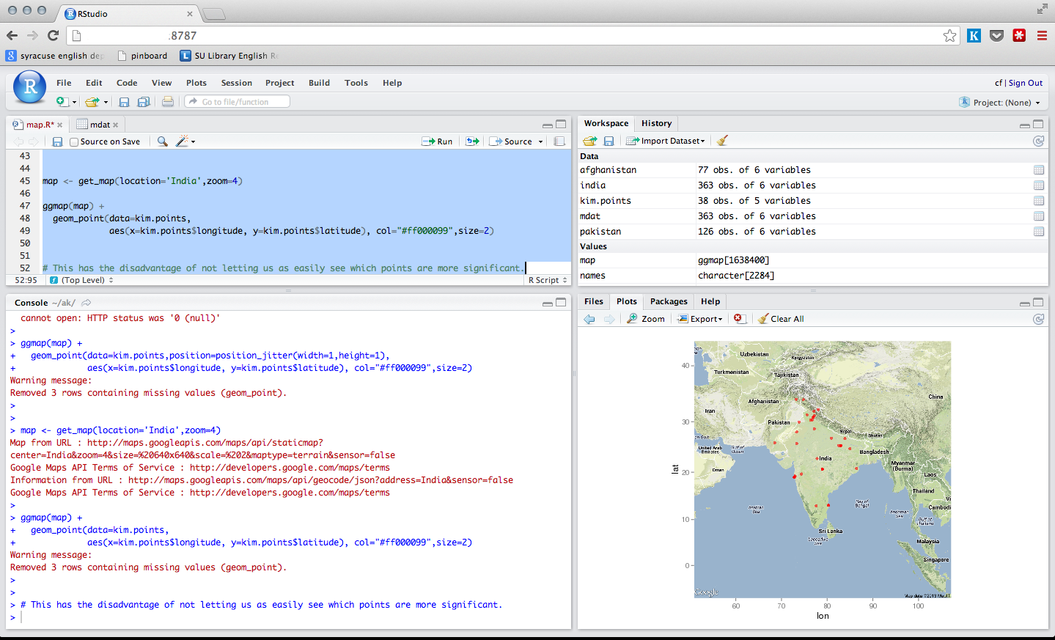
Workshop course
Most of our time will be spent thinking about, looking at, and writing code…
Course Structure
Data Science
Why R?
Coda

Slide 20
Essentially a programming course…
On the screen
Course Structure
Data Science
Why R?
Coda

Slide 21
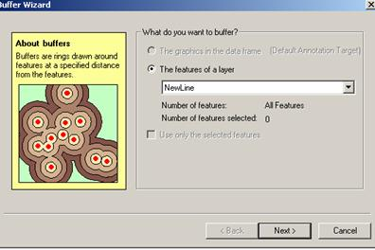
Why Code when you can Click?
Graphical User Interfaces are useful, especially when you are learning...
Course Structure
Data Science
Why R?
Coda

Slide 22
Reproducible Research
The ability to reproduce results from an experiment or analysis conducted by another*
Developed from literate programming:
Logic of the analysis is represented in output
Combines computer code with narrative
Literate Programming (1992) D.E. Knuth
Course Structure
Data Science
Why R?
Coda

Slide 23
Learning a programming language can help you learn how to think logically.
A man who does not know foreign language is ignorant of his own.
-- Johann Wolfgang von Goethe (1749 - 1832)

Slide 24
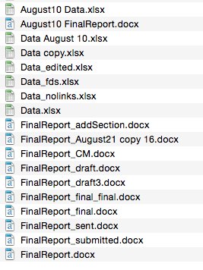
Typical GUI Workflow
Stata
Graphics
Tables
Summaries
Word
Data 1:
Field Data
Excel
Data 2:
Geotif
ArcGIS
Advisor:
I’ve updated the field data with a few more locations, please re-run that analysis…
New satellite data are available, can you update that figure?
Course Structure
Data Science
Why R?
Coda

Slide 25
Organized and repeatable workflow (and some example commands)
Scripts
Graphics
Tables
Summaries
‘Raw’ data
Gather
Clean
Prepare
Analysis
‘Raw’ data
Websites
Presentations
Manuscripts
‘Raw’ data
GDAL
GRASS GIS
dplyr
Statistics
Models
BUGS/JAGS
File.download
ROpenSci APIs
xtable
knitr/sweave
rmarkdown
Advisor:
I’ve updated the field data with a few more locations, please re-run that analysis…
New satellite data are available, can you update that figure?
Sure, I can do that
this afternoon…
Adapted from Gandrud (2014) Reproducible Research with R and RStudio.
Course Structure
Data Science
Why R?
Coda

Slide 26
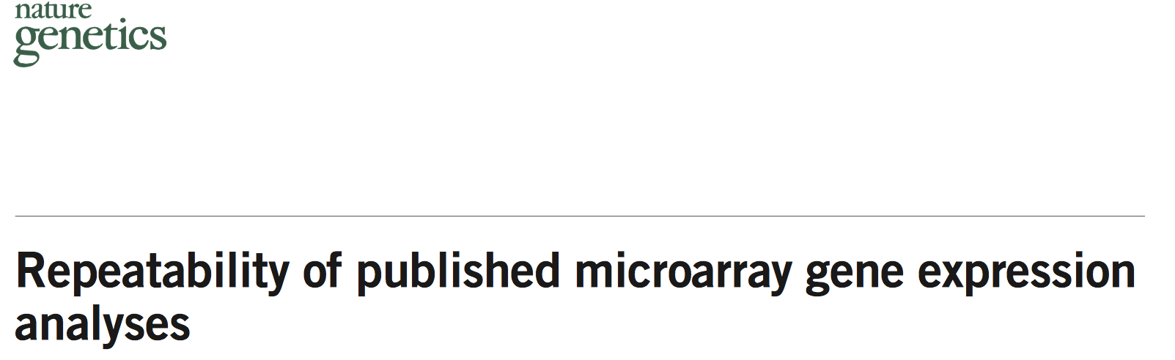
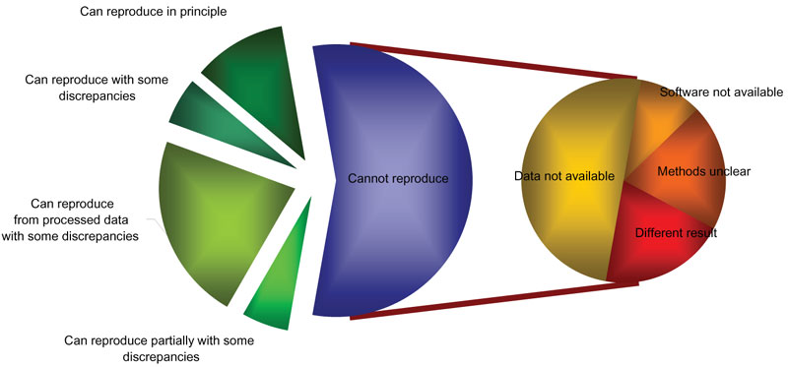
Reproducible Research
Repeatability of published microarray gene expression Analyses. Nature Genetics 41(2):149
18 articles:
2 reproducible
6 partially
10 could not be reproduced!
Course Structure
Data Science
Why R?
Coda

Slide 27
Programming gives you access to more computer power.
The computer is incredibly fast, accurate, and stupid. Man is unbelievably slow, inaccurate, and brilliant. The marriage of the two is a force beyond calculation. -- Leo Cherne

Slide 28
Organized and repeatable workflow (and some example commands)
Scripts
Graphics
Tables
Summaries
‘Raw’ data
Gather
Clean
Prepare
Analysis
‘Raw’ data
Websites
Presentations
Manuscripts
‘Raw’ data
Advisor:
I want you to take he analysis you developed for Buffalo and run it globally
Sure, I can do that
this afternoon…
Course Structure
Data Science
Why R?
Coda
Adapted from Gandrud (2014) Reproducible Research with R and RStudio.

Slide 29
From Graphical User Interface (GUI)
to scripting/programming
Write Code
Productivity
Point-and-click
My goal in
this course
Time
Course Structure
Data Science
Why R?
Coda

Slide 30
Typical software use - GEO
Software
ArcGIS 94%
Python 29%
R 29%
SPSS 29%
Google Earth Engine 24%
Erdas Imagine 24%
Scripting
Yes 71%
No 29%
Used R?
No 52%
Course Structure
Data Science
Why R?
Coda

Slide 31
The R Project for Statistical Computing
Free and Open source
Data manipulation
Data analysis tools
Great graphics
Programming language
6,000⁺ free, community-contributed packages
A supportive and increasing user community
R is a dialect of the S language developed at Bell Laboratories (formerly AT&T) by John Chambers et. al. (same group developed C and UNIX©)
Course Structure
Data Science
Why R?
Coda

Slide 32
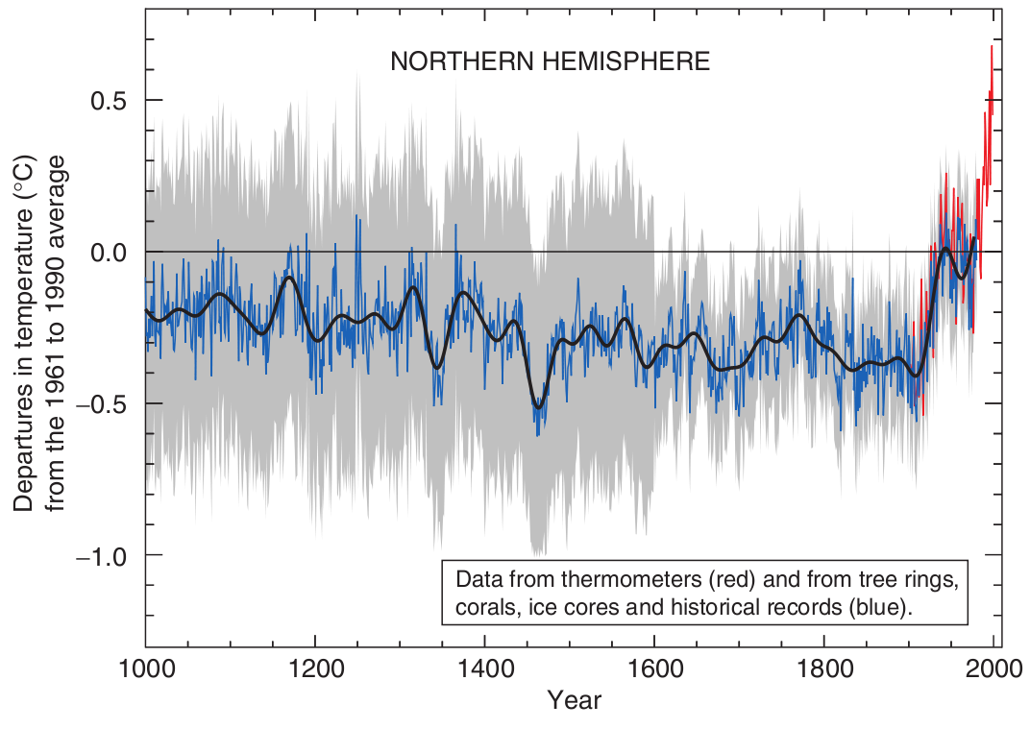
Reproducible, Portable, & Transparent
. . . all the code and data used to recreate the Mann’s original analysis has been made available to the public [...] Since the analysis is in R, anyone can replicate the results and examine the methods.
(Matthew Pocernich, R news 6/4, 10/31/06)‏
http://www.cgd.ucar.edu/ccr/ammann/millennium/refs/WahlAmmann_ClimChange2006.html
Course Structure
Data Science
Why R?
Coda

Slide 33
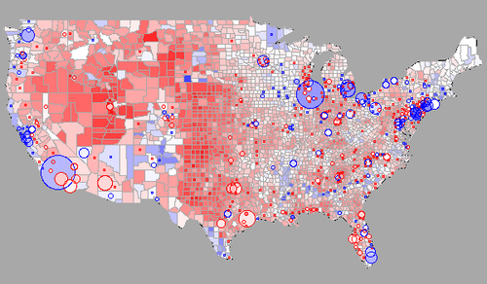
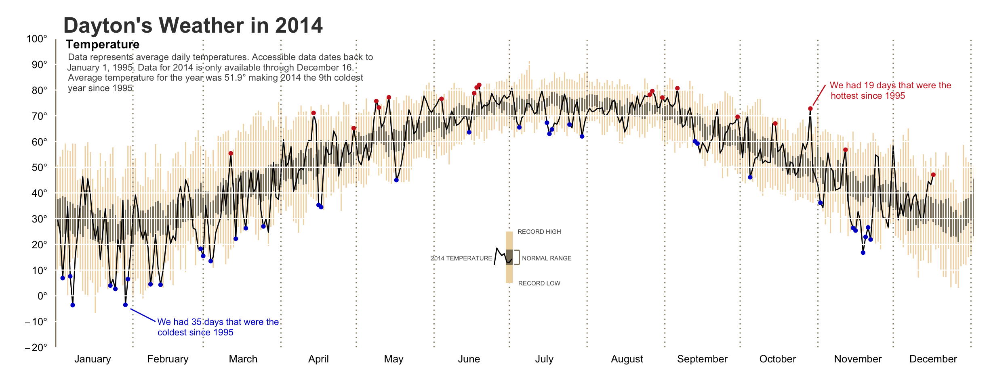
R Graphics
If you can imagine it…
http://blog.revolutionanalytics.com/2009/01/r-graph-gallery.html
http://rpubs.com/bradleyboehmke/weather_graphic
Course Structure
Data Science
Why R?
Coda

Slide 34
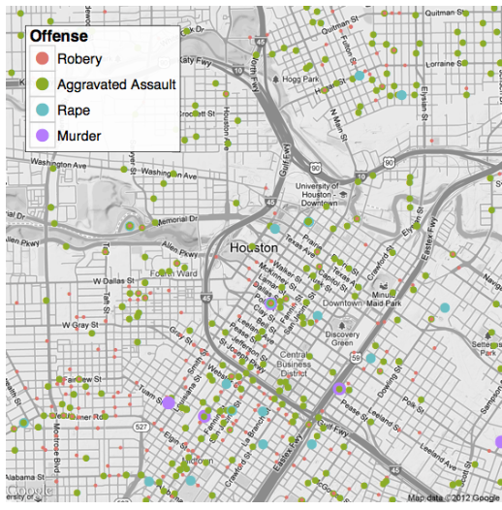
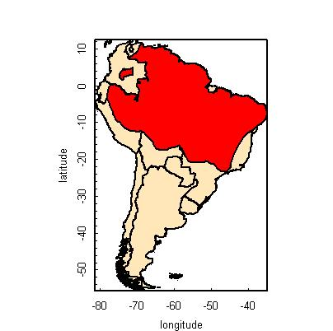
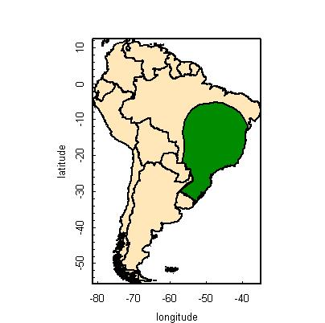
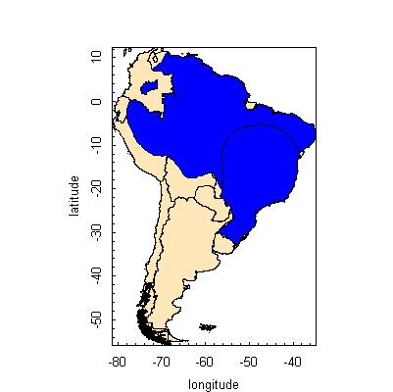
Spatial data in R
Packages: sp, maptools, rgeos, raster, ggmap
Examples:
species range overlays
Basemaps with ggmap
+
=
http://www.nceas.ucsb.edu/
http://journal.r-project.org/archive/2013-1/kahle-wickham.pdf
Course Structure
Data Science
Why R?
Coda

Slide 35
Parallel Processing
For BIG jobs:
multi-core processors / high performance computing with foreach.
Output
Data
Script
Processor #1
Processor #2
Processor #3
Course Structure
Data Science
Why R?
Coda

Slide 36
Strengths & Limitations
Just-in-time compilation:
Slower than compiled languages (-)
Faster to compose (+)
Many available packages (+)
Most operations conducted in RAM
RAM can be limiting and/or expensive (-)
“Error: cannot allocate vector of size X Mb”
Various packages and clever programming can overcome this… (+)
Free like beer and speech! (+)
Course Structure
Data Science
Why R?
Coda

Slide 37
R Interface
But there are
other options...
Course Structure
Data Science
Why R?
Coda

Slide 38
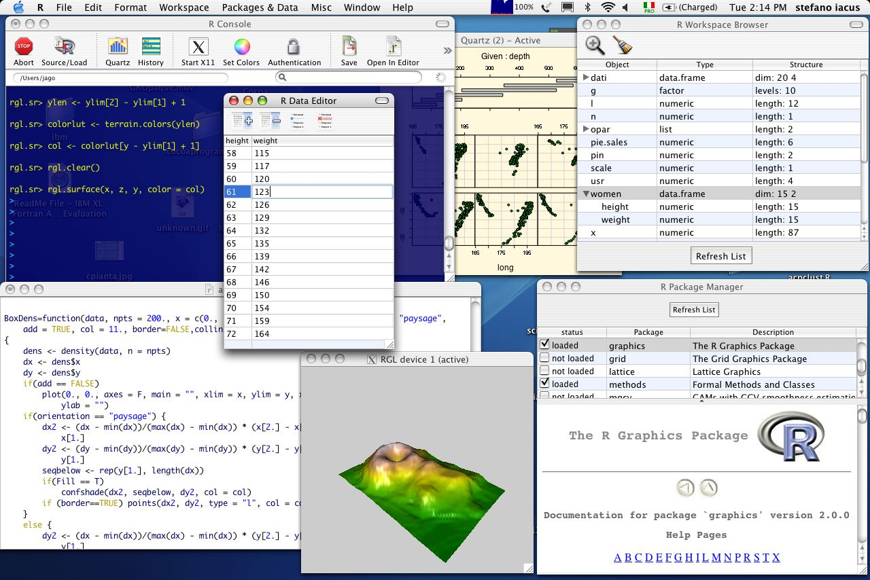
R in Mac
Course Structure
Data Science
Why R?
Coda

Slide 39
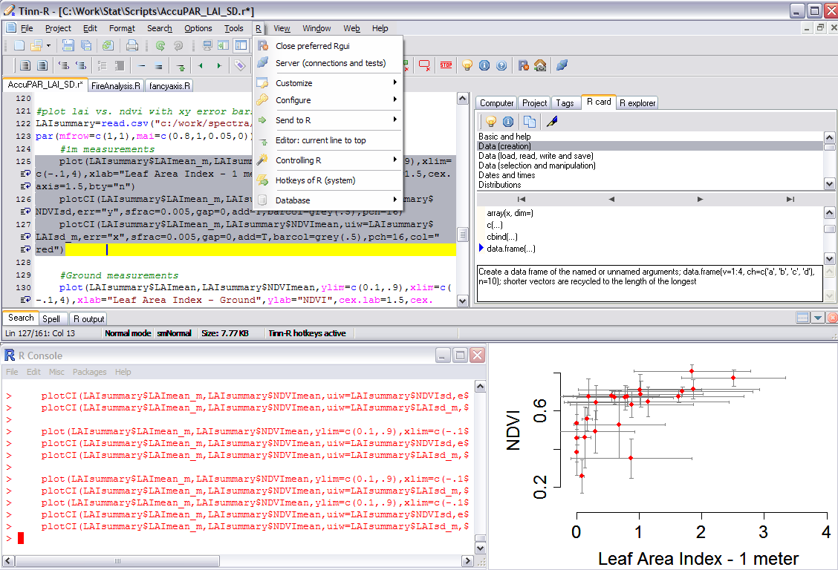
R in Windows
Course Structure
Data Science
Why R?
Coda

Slide 40

Course Structure
Data Science
Why R?
Coda
Mac, Windows, Linux, and over the web…

Slide 41
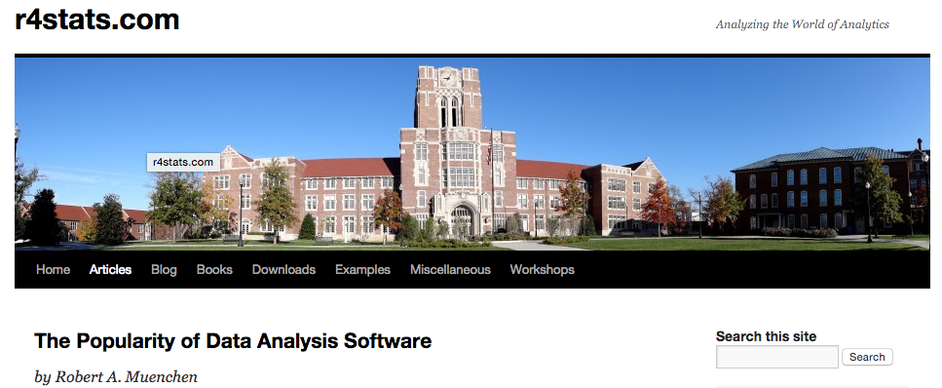
Who uses R?
http://r4stats.com/articles/popularity/
Course Structure
Data Science
Why R?
Coda

Slide 42
“Data Science” Jobs on indeed.com
The number of data science jobs for the more popular software (those with 250 jobs or more, 2/2017).
Feb 2017: http://r4stats.com/articles/popularity/
Course Structure
Data Science
Why R?
Coda

Slide 43
Scholarly articles by software package
Number of scholarly articles found in the most recent complete year (2016) for each software package used as a topic or tool of analysis. For methods see here.
http://r4stats.com/articles/popularity/
Course Structure
Data Science
Why R?
Coda

Slide 44
Change in scholarly articles
http://r4stats.com/articles/popularity/
The number of scholarly articles found in each year by Google Scholar. Only the top six “classic” statistics packages are shown.
The number of scholarly articles found in each year by Google Scholar (excluding SAS and SPSS).

Slide 45
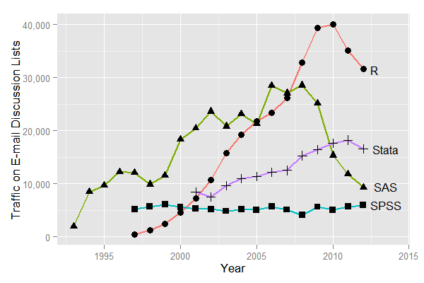
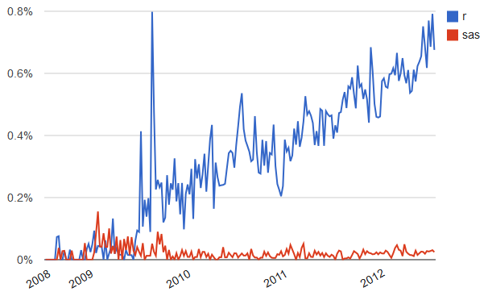
Forum/discussion activity
Sum of monthly email traffic on each software’s main listserv discussion list.
Number of R- or SAS-related posts to Stack Overflow (programming and statistical topics) by week.
http://r4stats.com/articles/popularity/
Course Structure
Data Science
Why R?
Coda

Slide 46
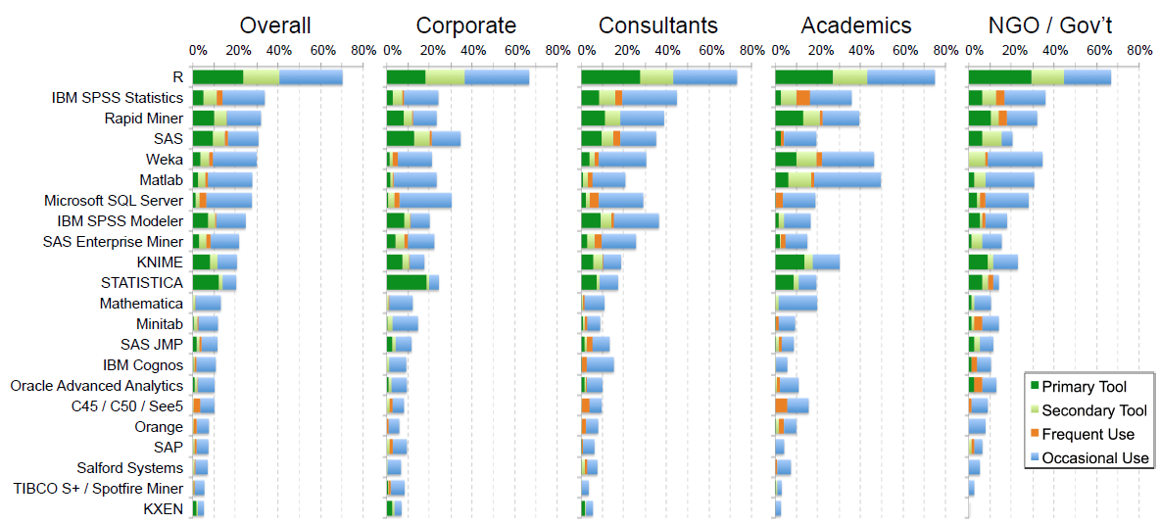
Rexer Analytics Data Miner Survey (2013)
~1.2k respondents http://r4stats.com/articles/popularity/
Course Structure
Data Science
Why R?
Coda

Slide 47
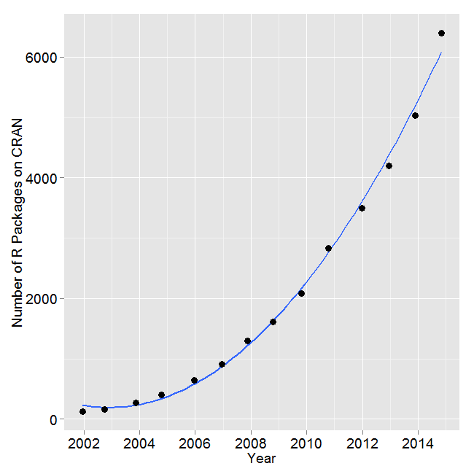
R Development
Number of R packages available on its main distribution site for the last version released in each year.
SAS v9.3: 1.2k commands
(in Base, Stat, ETS, HP Forecasting, Graph, IML, Macro, OR, QC.)
2014: R added 1.3k packages and ~27k functions.
Over 6k packages!
Task Views organize packages by topic: http://cran.r-project.org/web/views/
http://r4stats.com/articles/popularity/
Course Structure
Data Science
Why R?
Coda

Slide 48



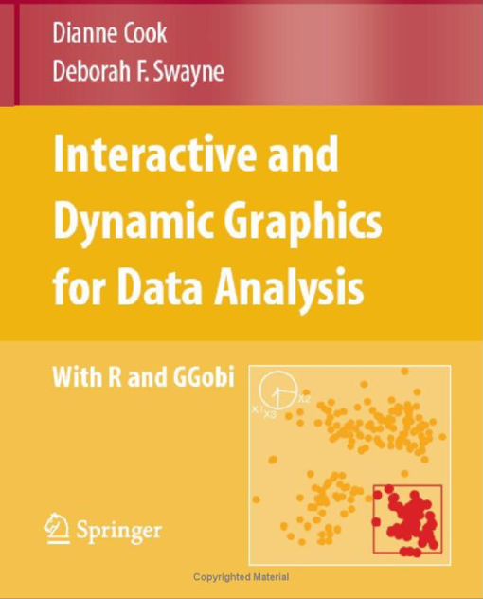
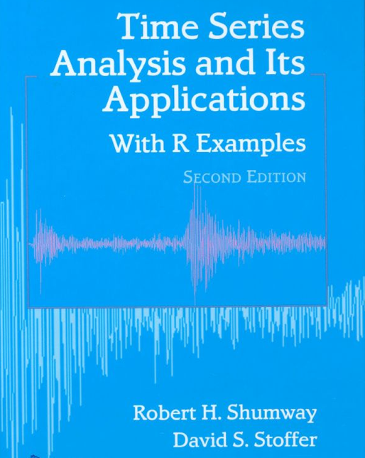
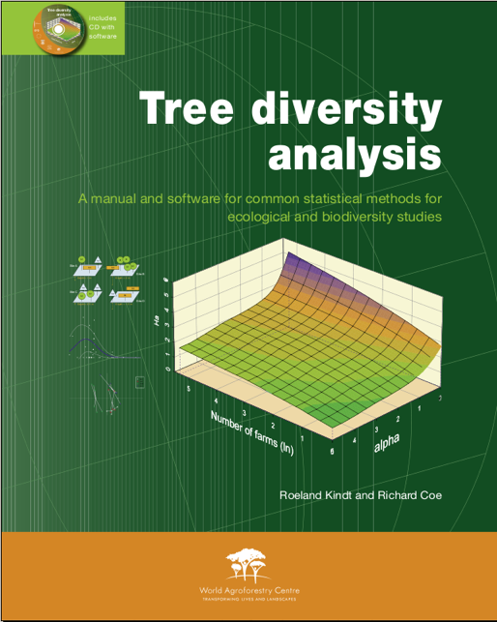

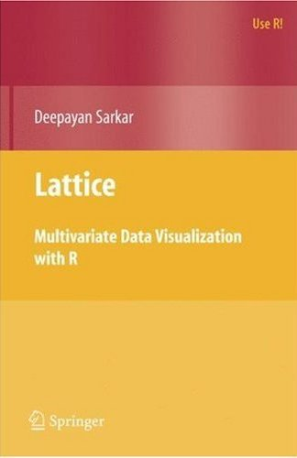

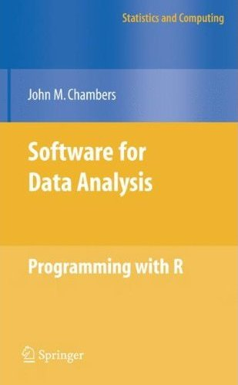

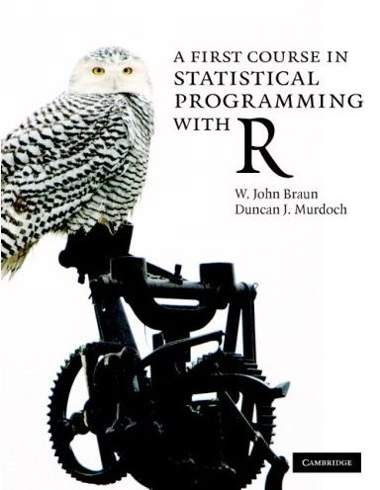



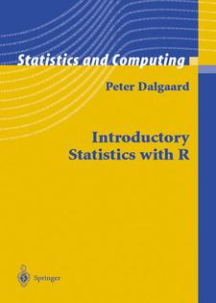

240 Books on R since 2000
Course Structure
Data Science
Why R?
Coda

Slide 49
R is a great language to learn and it can take you far…
But others (python, etc.) are useful too. Once you learn one, it is much faster to learn others
Course Structure
Data Science
Why R?
Coda

Slide 50










A little about me…
Ecology
Earth Science
Sustainable Development
Ecology
Geography
Climate Change Mitigation
Course Structure
Data Science
Why R?
Coda
Notes:
Shiang-yu Jiang

Slide 51
And who are you?
Name
Where are you from (state and/or country)?
Department/Degree (e.g. MS GIS)
Research Interests
Motivation for taking this course (what do you want to learn?)
~1 minute each!
Course Structure
Data Science
Why R?
Coda

Slide 52
Before next class
Explore adamwilson.us/SpatialDataScience
Install RStudio on your laptop from https://www.rstudio.com
Read and work through the first two chapters of R For Data Science (link on website)
Course Structure
Data Science
Why R?
Coda

Slide 53
Installing R and RStudio
Install
R https://cran.revolutionanalytics.com/
RStudio https://www.rstudio.com
Course Structure
Data Science
Why R?
Coda

